Slide 1
Missing Children Minnesota Application

Slide 2
MCM Screen Flow
Login
MCM
My Children
My Children
Add/Edit Photo
My Children
Child Profile
Child Basics
Home DNA
Safety for Children
Missing Child
About MCM
Measurements
Physical Details
Doctor Info
Dental Info
Medical Alert Info
Distinguishing Features
I.D. Checklist
Measurements
Distinguishing Features
Measurements
Distinguishing Features
Add/Edit Measurement
Add/EditDistinguishing Features

Slide 3
The Login screen will be used to authenticate the User.
Authentication will either be through a Microsoft account, Gmail account, or Twitter account.
Once Authenticated, the User will be taken to the MCM screen.
Informational static screens:
Home DNA
Safety for Children
Missing Child
About MCM
MyChildren screen: This screen will displays a list of children associated with the logged in User account.
If there is no Children associated with the User account, the screen will display a “You haven’t added your children yet” text.
If there is children associated with the logged in User account, a list of the associated children will be displayed.
Children are added through the Child Profile screens.
Child Profile screens:
Add Photo –Used to add/edit photo of the child.
Child Basics – This is the first screen when adding a child to the list. Name and date of birth are required to add a child to the list.
Measurements screen: This screen displays a list of the Measurements (height, weight) taken.
Physical Details – hair color, eye color, etc.
Doctor Info
Dental Info
Medical Alert Info
Distinguishing Features screen: This screen displays a list of birthmarks, scars, etc. on the child body.
I.D. CheckList – A list of items to be included in an I.D. folder for each child. The User can check off each item placed in the folder.

Slide 4
A User account may have one or more Child objects.
A Child object may have one or more Child Measurements.
A Child object may have one or more Distinguishing Features.
A Child object may have one or more I.D. Check List items checked.
When the User navigates to the My Children screen, the User can add a Child to the list.
To add a child to the list:
The User will click on the “Add a Child” icon in the Action Bar.
A new Child object will be created. The Child object will not have a ChildId at this point.
The application will navigate to the Child Profile screen.
The only available navigation buttons under Child Profile will be Child Basics. Other Child Profile navigation buttons (Child Measurements, Doctor Info, Dental Info, Distinguishing Features, etc.) are disabled, at this point.
Once all the necessary information has been entered and saved in Child Basics, a ChildId is assigned. The User can then navigate to the other Child Profile screens and enter other child information.
The other Child Profile screens are only available on an existing child (has an assigned ChildId).
Removing a child from the list can be done through the Child Basic screen.

Slide 5
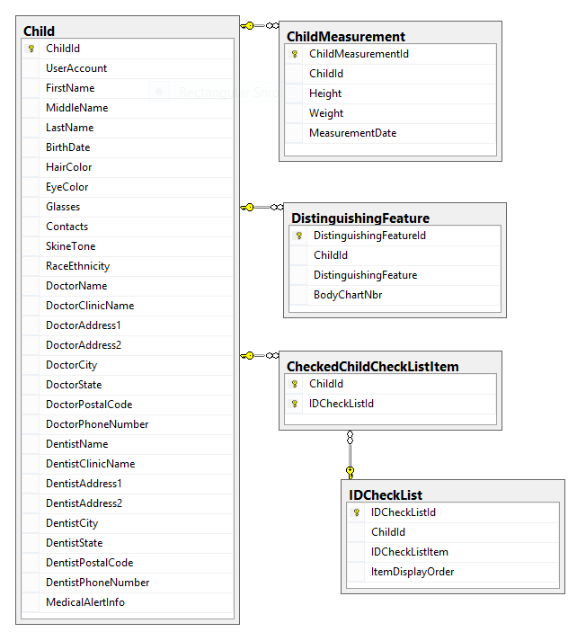

Slide 6
Database Tables
CREATE TABLE [dbo].[Child](
[ChildId] [int] NOT NULL,
[UserAccount] [varchar](50) NOT NULL,
[FirstName] [varchar](50) NOT NULL,
[MiddleName] [varchar](50) NOT NULL,
[LastName] [varchar](50) NOT NULL,
[BirthDate] [datetime] NOT NULL,
[HairColor] [varchar](50) NOT NULL,
[EyeColor] [varchar](50) NOT NULL,
[Glasses] [bit] NOT NULL,
[Contacts] [bit] NOT NULL,
[SkineTone] [varchar](50) NOT NULL,
[RaceEthnicity] [varchar](50) NOT NULL,
[DoctorName] [varchar](150) NULL,
[DoctorClinicName] [varchar](255) NULL,
[DoctorAddress1] [varchar](150) NULL,
[DoctorAddress2] [varchar](150) NULL,
[DoctorCity] [varchar](50) NULL,
[DoctorState] [varchar](50) NULL,
[DoctorPostalCode] [varchar](50) NULL,
[DoctorPhoneNumber] [varchar](50) NULL,
[DentistName] [varchar](150) NULL,
[DentistClinicName] [varchar](150) NULL,
[DentistAddress1] [varchar](150) NULL,
[DentistAddress2] [varchar](150) NULL,
[DentistCity] [varchar](50) NULL,
[DentistState] [varchar](50) NULL,
[DentistPostalCode] [varchar](50) NULL,
[DentistPhoneNumber] [varchar](50) NULL,
[MedicalAlertInfo] [varchar](500) NULL,
CONSTRAINT [PK_Child] PRIMARY KEY CLUSTERED
(
[ChildId] ASC
)WITH (PAD_INDEX = OFF, STATISTICS_NORECOMPUTE = OFF, IGNORE_DUP_KEY = OFF, ALLOW_ROW_LOCKS = ON, ALLOW_PAGE_LOCKS = ON) ON [PRIMARY]
) ON [PRIMARY]

Slide 7
CREATE TABLE [dbo].[ChildMeasurement](
[ChildMeasurementId] [int] NOT NULL,
[ChildId] [int] NOT NULL,
[Height] [varchar](50) NOT NULL,
[Weight] [varchar](50) NOT NULL,
[MeasurementDate] [date] NOT NULL,
CONSTRAINT [PK_ChildMeasurement] PRIMARY KEY CLUSTERED
(
[ChildMeasurementId] ASC
)WITH (PAD_INDEX = OFF, STATISTICS_NORECOMPUTE = OFF, IGNORE_DUP_KEY = OFF, ALLOW_ROW_LOCKS = ON, ALLOW_PAGE_LOCKS = ON) ON [PRIMARY]
) ON [PRIMARY]
GO
SET ANSI_PADDING OFF
GO
ALTER TABLE [dbo].[ChildMeasurement] WITH CHECK ADD CONSTRAINT [FK_ChildMeasurement_Child] FOREIGN KEY([ChildId])
REFERENCES [dbo].[Child] ([ChildId])
ON DELETE CASCADE
GO
ALTER TABLE [dbo].[ChildMeasurement] CHECK CONSTRAINT [FK_ChildMeasurement_Child]
GO

Slide 8
CREATE TABLE [dbo].[DistinguishingFeature](
[DistinguishingFeatureId] [int] NOT NULL,
[ChildId] [int] NOT NULL,
[DistinguishingFeature] [varchar](255) NOT NULL,
[BodyChartNbr] [int] NULL,
CONSTRAINT [PK_DistinguishingFeature] PRIMARY KEY CLUSTERED
(
[DistinguishingFeatureId] ASC
)WITH (PAD_INDEX = OFF, STATISTICS_NORECOMPUTE = OFF, IGNORE_DUP_KEY = OFF, ALLOW_ROW_LOCKS = ON, ALLOW_PAGE_LOCKS = ON) ON [PRIMARY]
) ON [PRIMARY]
GO
SET ANSI_PADDING OFF
GO
ALTER TABLE [dbo].[DistinguishingFeature] WITH CHECK ADD CONSTRAINT [FK_DistinguishingFeature_Child] FOREIGN KEY([ChildId])
REFERENCES [dbo].[Child] ([ChildId])
ON DELETE CASCADE
GO
ALTER TABLE [dbo].[DistinguishingFeature] CHECK CONSTRAINT [FK_DistinguishingFeature_Child]
GO

Slide 9
CREATE TABLE [dbo].[IDCheckList](
[IDCheckListId] [int] NOT NULL,
[ChildId] [int] NOT NULL,
[IDCheckListItem] [varchar](255) NOT NULL,
[ItemDisplayOrder] [int] NOT NULL,
CONSTRAINT [PK_IDCheckList] PRIMARY KEY CLUSTERED
(
[IDCheckListId] ASC
)WITH (PAD_INDEX = OFF, STATISTICS_NORECOMPUTE = OFF, IGNORE_DUP_KEY = OFF, ALLOW_ROW_LOCKS = ON, ALLOW_PAGE_LOCKS = ON) ON [PRIMARY]
) ON [PRIMARY]
GO
SET ANSI_PADDING OFF
GO
CREATE TABLE [dbo].[CheckedChildCheckListItem](
[ChildId] [int] NOT NULL,
[IDCheckListId] [int] NOT NULL,
CONSTRAINT [PK_CheckedChildCheckListItem] PRIMARY KEY CLUSTERED
(
[ChildId] ASC,
[IDCheckListId] ASC
)WITH (PAD_INDEX = OFF, STATISTICS_NORECOMPUTE = OFF, IGNORE_DUP_KEY = OFF, ALLOW_ROW_LOCKS = ON, ALLOW_PAGE_LOCKS = ON) ON [PRIMARY]
) ON [PRIMARY]
GO
ALTER TABLE [dbo].[CheckedChildCheckListItem] WITH CHECK ADD CONSTRAINT [FK_CheckedChildCheckListItem_Child] FOREIGN KEY([ChildId])
REFERENCES [dbo].[Child] ([ChildId])
ON DELETE CASCADE
GO
ALTER TABLE [dbo].[CheckedChildCheckListItem] CHECK CONSTRAINT [FK_CheckedChildCheckListItem_Child]
GO
ALTER TABLE [dbo].[CheckedChildCheckListItem] WITH CHECK ADD CONSTRAINT [FK_CheckedChildCheckListItem_IDCheckList] FOREIGN KEY([IDCheckListId])
REFERENCES [dbo].[IDCheckList] ([IDCheckListId])
GO
ALTER TABLE [dbo].[CheckedChildCheckListItem] CHECK CONSTRAINT [FK_CheckedChildCheckListItem_IDCheckList]
GO

